Slide 1


Rating System Design: Structure, Incentives, and Fees
Titing Cui¹, Michael L. Hamilton¹, Su Jia²
¹ Katz Graduate School of Business, University of Pittsburgh,
² Department of Operations Research and Industrial Engineering, Cornell University

Slide 2
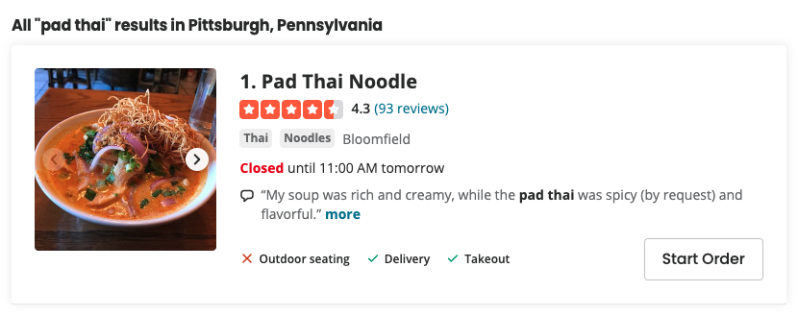
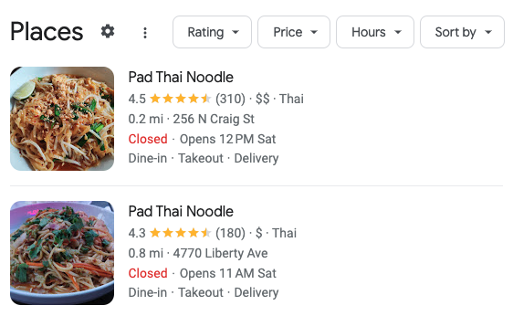
Rating Systems in Practice
Def: A Rating System aggregates outcomes into a single numeric measure of service quality.
Facilitates trust between a service provider and buyer^{[1]}
88% of shoppers investigate reviews before purchasing ^{[3]}
Many online platforms uses a simple weighted average to aggregate reviews into ratings.
Google Reviews, Yelp ^{[2]}
Does not account for recency of review in rating
No incentive to “defend” high rating
Strong incentive for strategic manipulation of ratings ^{[1,4]}
Fake reviews, coercion, market failure etc.
Ex 1.: Pad Thai near me from Yelp.com
Ex 2.: Pad Thai near me from Google Reviews
[1] S. Taledis, 2016. Reputation and Feedback Systems in Online Platform Markets.
[2] Mahfuze. 2023. Optimal Design of Ratings History
[3] https://www.powerreviews.com/insights/information-shoppers-want-product-reviews/
[4] M. Luca, 2017. Designing Online Marketplaces: Trust and Reputation Mechanisms

Slide 3
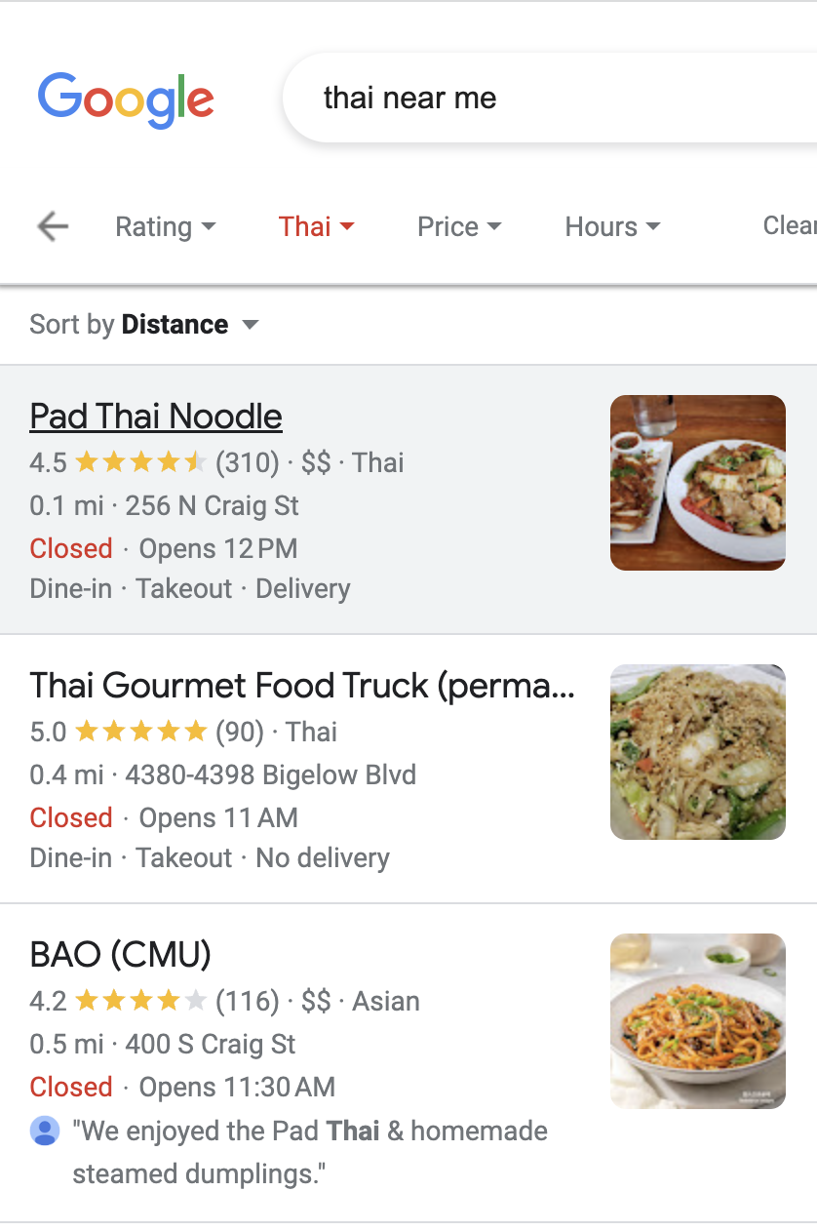
Rating Systems in Practice: Stale Ratings
Def: A Rating System aggregates outcomes into a single numeric measure of service quality.
Facilitates trust between a service provider and buyer^{[1]}
88% of shoppers investigate reviews before purchasing ^{[3]}
Def: We call a rating stale if it’s based off old transactions
38% of shoppers won’t purchase a product if the only reviews available are older than 90 days ^{[3]}
Ex.: Google reviews summary for Pad Thai Noodle
[1] S. Taledis, 2016. Reputation and Feedback Systems in Online Platform Markets.
[3] https://www.powerreviews.com/insights/information-shoppers-want-product-reviews/
[4] M. Luca, 2017. Designing Online Marketplaces: Trust and Reputation Mechanisms

Slide 4
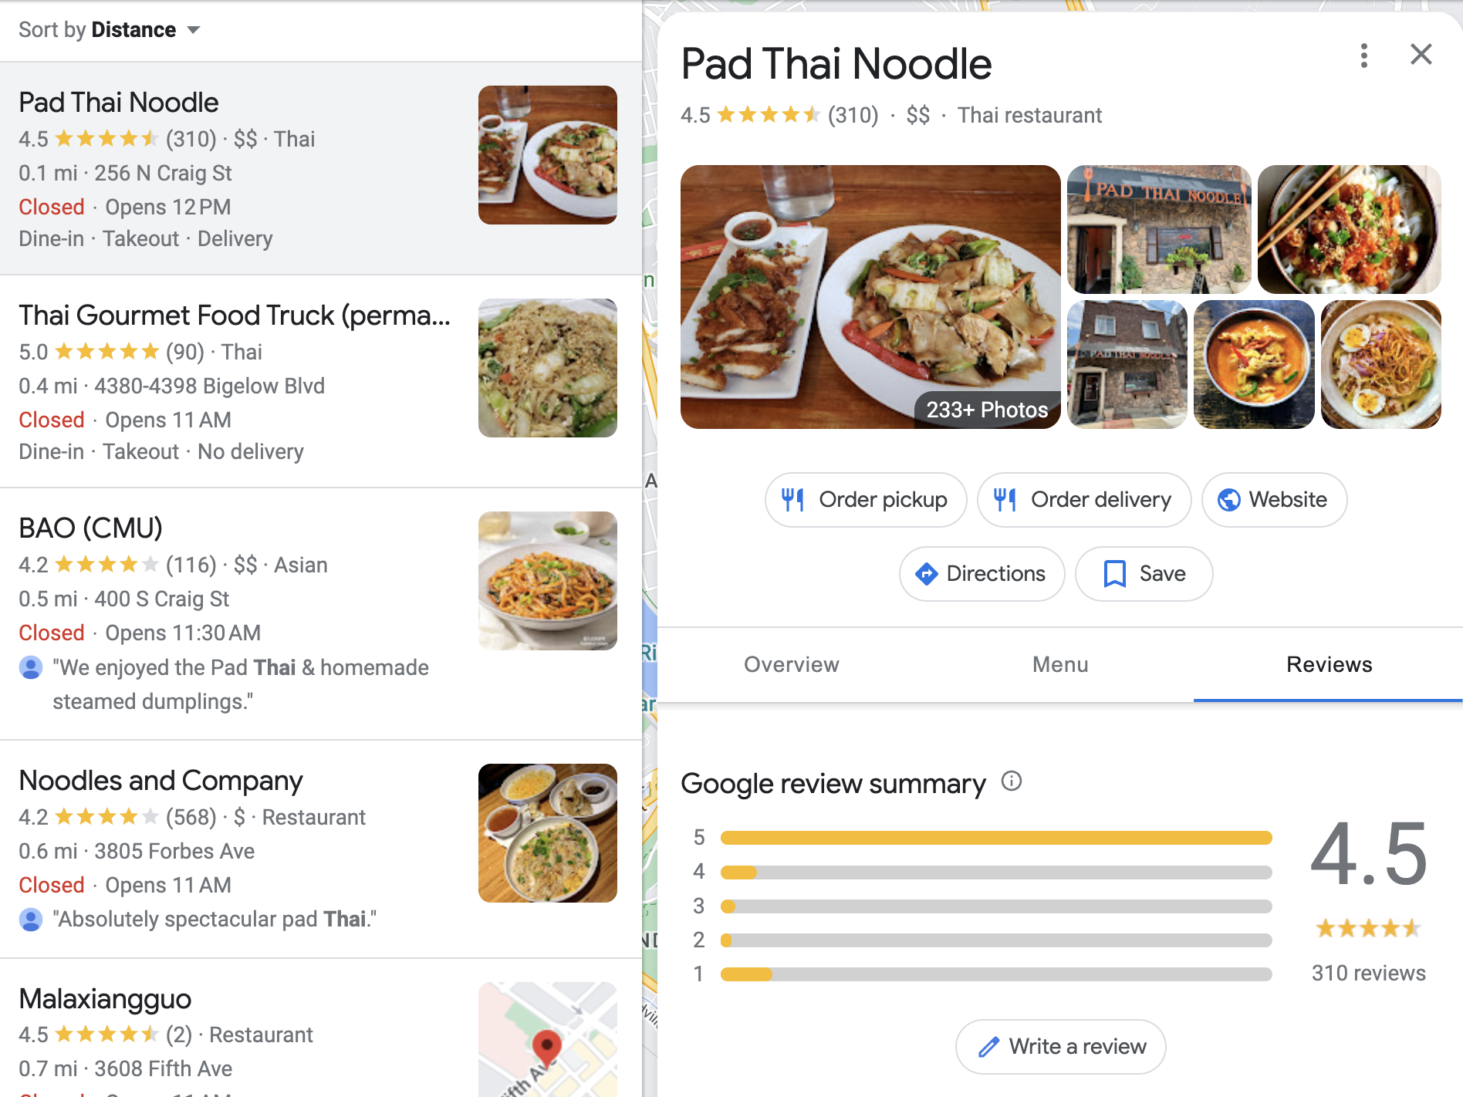
Rating Systems in Practice: Stale Ratings
Def: A Rating System aggregates outcomes into a single numeric measure of service quality.
Facilitates trust between a service provider and buyer^{[1]}
88% of shoppers investigate reviews before purchasing ^{[3]}
Def: We call a rating stale if it’s based off old transactions
38% of shoppers won’t purchase a product if the only reviews available are older than 90 days ^{[3]}
Ex.: Google review summary for Pad Thai Noodle
[1] S. Taledis, 2016. Reputation and Feedback Systems in Online Platform Markets.
[3] https://www.powerreviews.com/insights/information-shoppers-want-product-reviews/
[4] M. Luca, 2017. Designing Online Marketplaces: Trust and Reputation Mechanisms

Slide 5
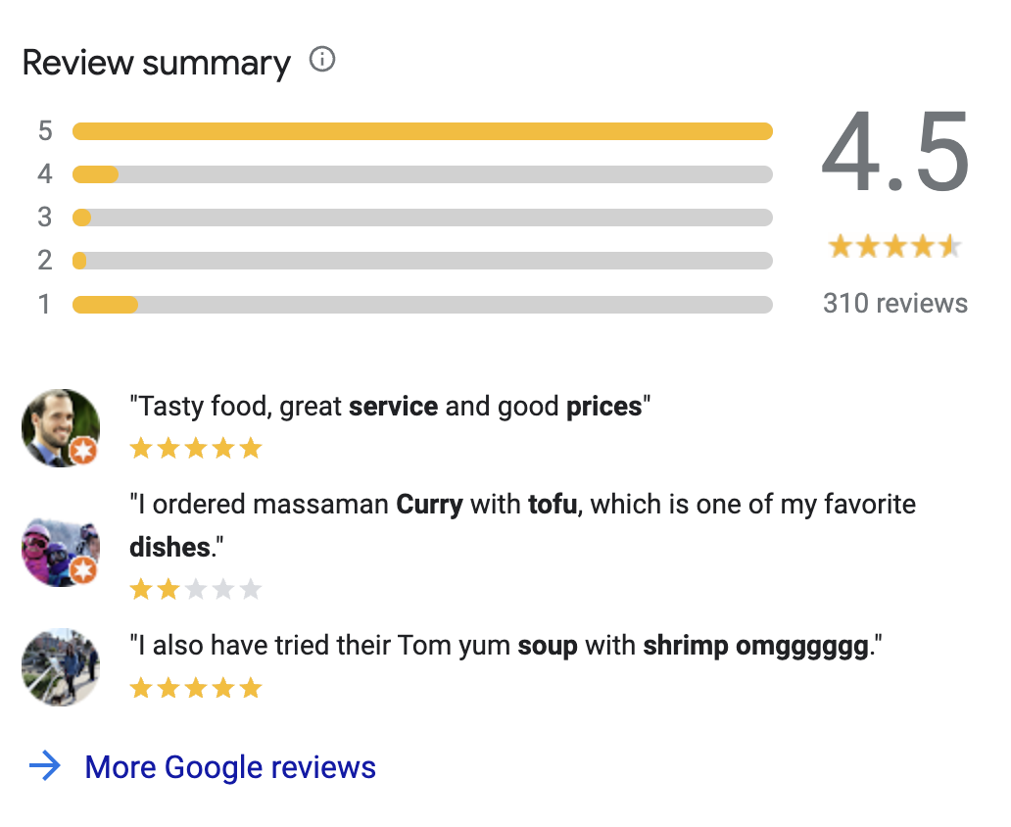
Rating Systems in Practice: Stale Ratings
Def: A Rating System aggregates outcomes into a single numeric measure of service quality.
Facilitates trust between a service provider and buyer^{[1]}
88% of shoppers investigate reviews before purchasing ^{[3]}
Def: We call a rating stale if it’s based off old transactions
38% of shoppers won’t purchase a product if the only reviews available are older than 90 days ^{[3]}
Ex.: Google review summary for Pad Thai Noodle
[1] S. Taledis, 2016. Reputation and Feedback Systems in Online Platform Markets.
[3] https://www.powerreviews.com/insights/information-shoppers-want-product-reviews/
[4] M. Luca, 2017. Designing Online Marketplaces: Trust and Reputation Mechanisms

Slide 6
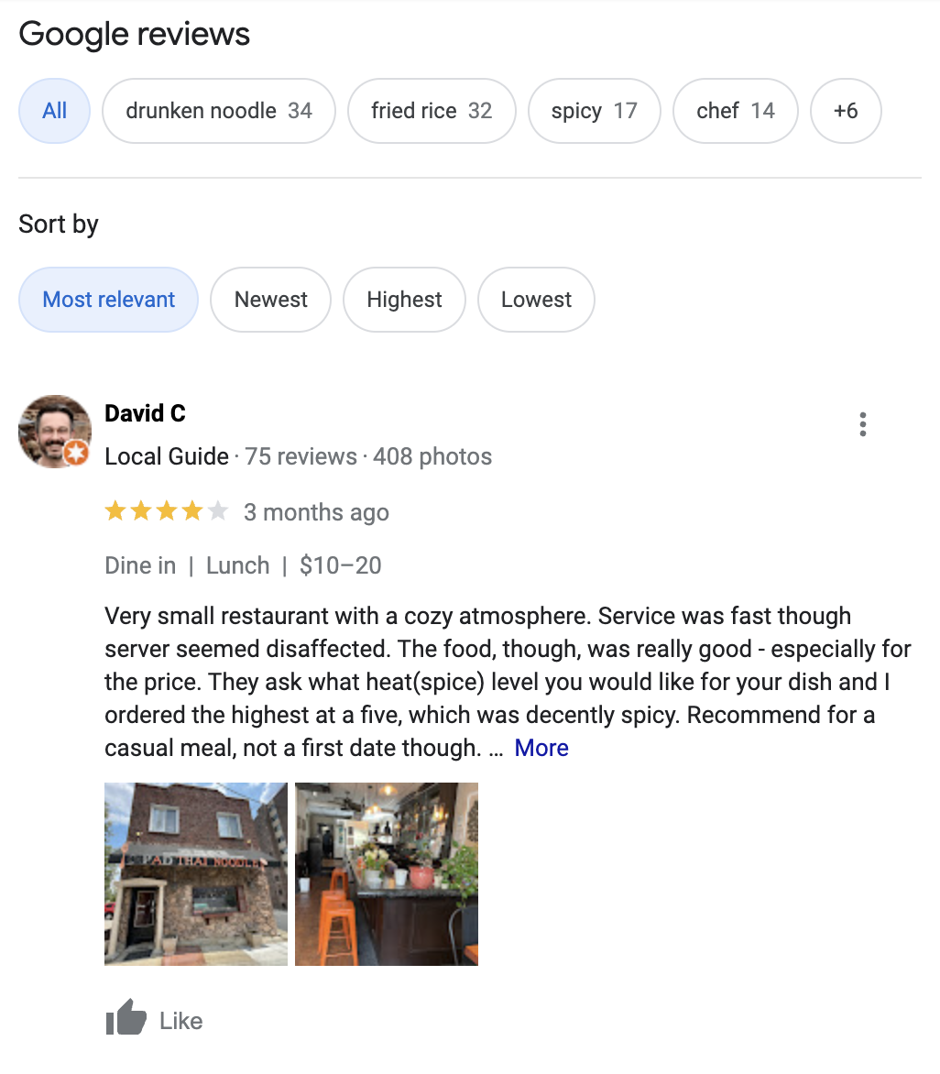
Rating Systems in Practice: Stale Ratings
Def: A Rating System aggregates outcomes into a single numeric measure of service quality.
Facilitates trust between a service provider and buyer^{[1]}
88% of shoppers investigate reviews before purchasing ^{[3]}
Def: We call a rating stale if it’s based off old transactions
38% of shoppers won’t purchase a product if the only reviews available are older than 90 days ^{[3]}
Ex.: Reviews seem good at first glance…
[1] S. Taledis, 2016. Reputation and Feedback Systems in Online Platform Markets.
[3] https://www.powerreviews.com/insights/information-shoppers-want-product-reviews/
[4] M. Luca, 2017. Designing Online Marketplaces: Trust and Reputation Mechanisms

Slide 7
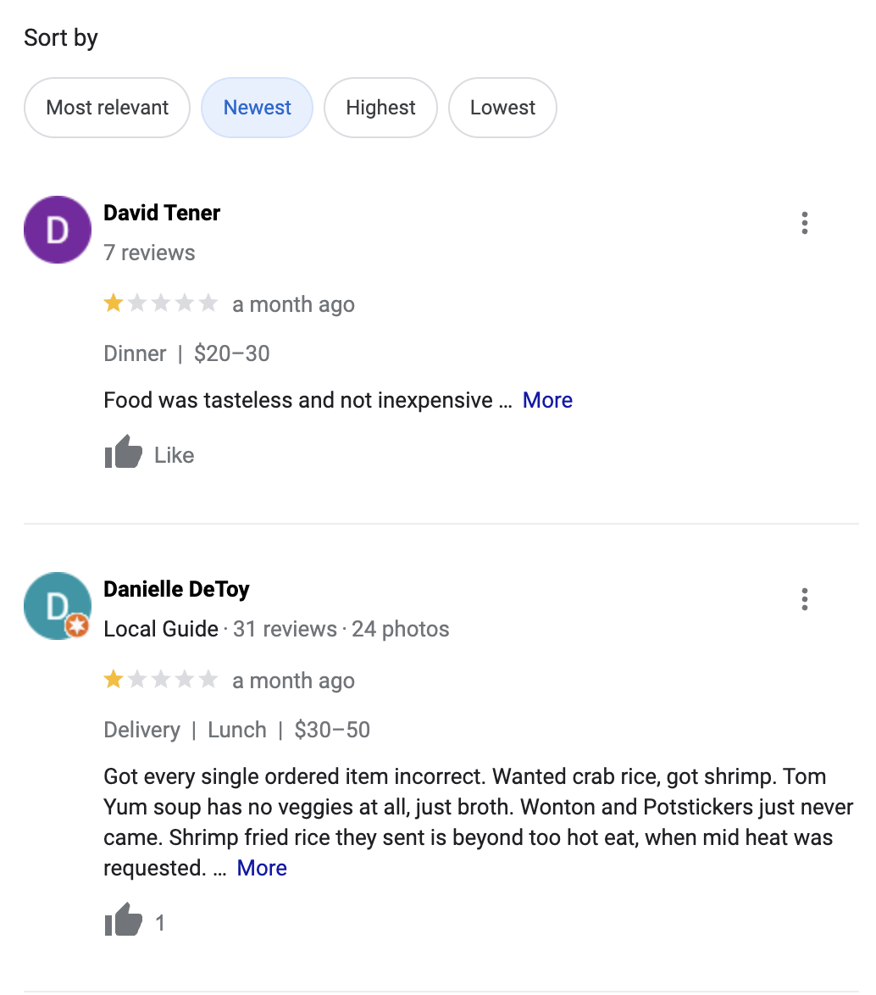
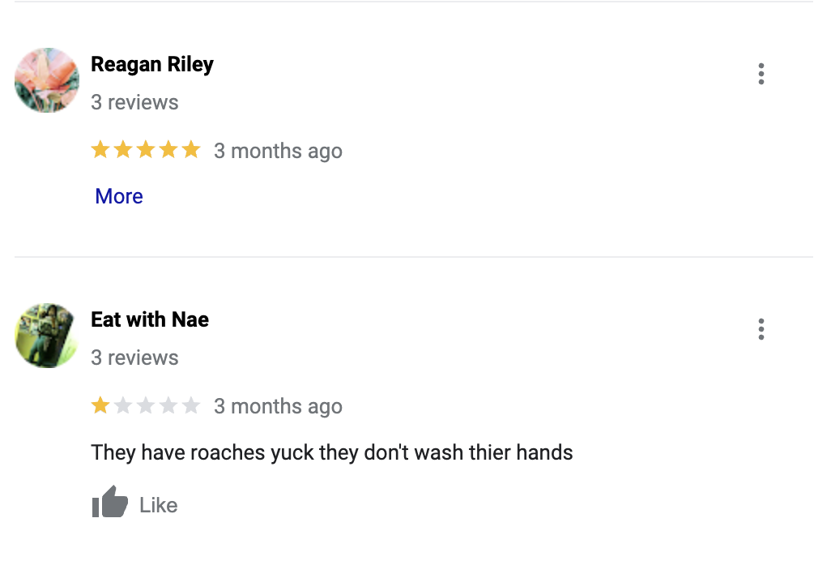
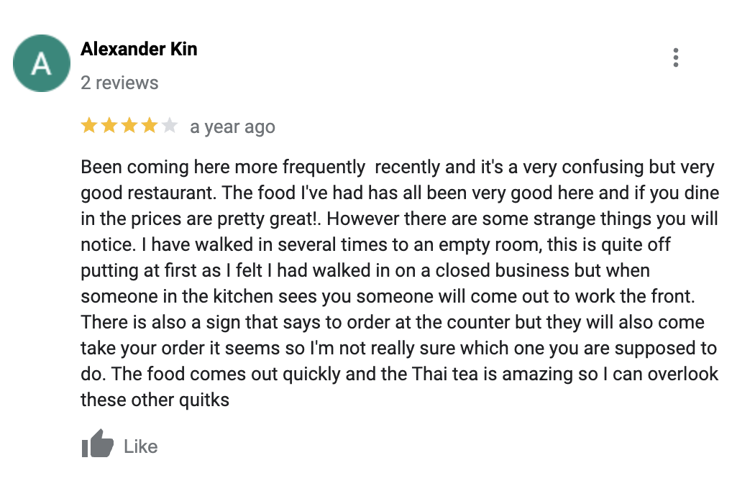
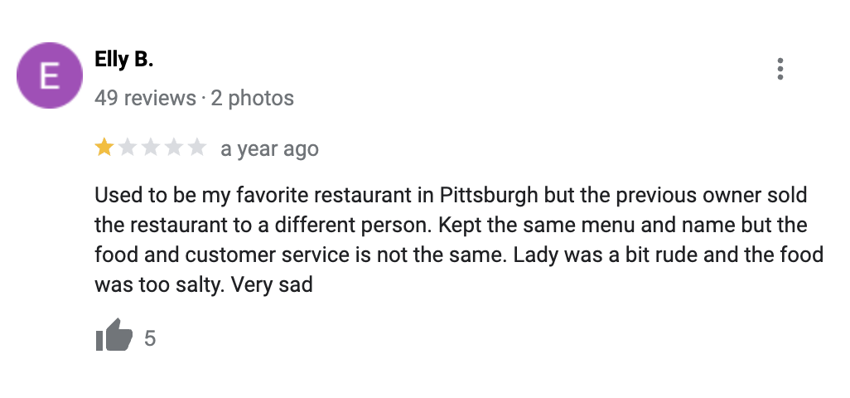
Rating Systems in Practice: Stale Ratings
Def: A Rating System aggregates outcomes into a single numeric measure of service quality.
Facilitates trust between a service provider and buyer^{[1]}
88% of shoppers investigate reviews before purchasing ^{[3]}
Def: We call a rating stale if it’s based off old transactions
38% of shoppers won’t purchase a product if the only reviews available are older than 90 days ^{[3]}
Ex.: By investigating, the truth is revealed
[1] S. Taledis, 2016. Reputation and Feedback Systems in Online Platform Markets.
[3] https://www.powerreviews.com/insights/information-shoppers-want-product-reviews/
[4] M. Luca, 2017. Designing Online Marketplaces: Trust and Reputation Mechanisms

Slide 8
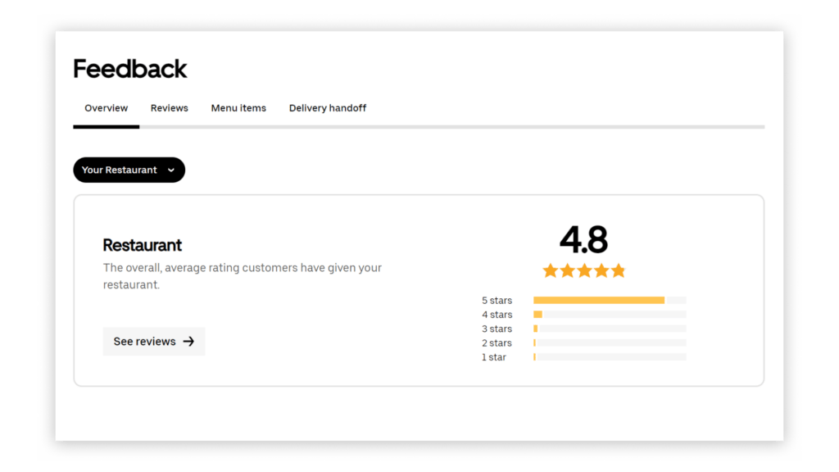



Rating Systems in Practice: Market Disintermediation
Def: A Rating System aggregates outcomes into a single numeric measure of service quality.
Facilitates trust between a service provider and buyer
88% of shoppers investigate reviews before purchasing
Def: We call a rating stale if it’s based off old transactions
38% of shoppers won’t purchase a product if the only reviews available are older than 90 days
Def: On a platform disintermediation occurs when users connect to services on the platform but transact off the platform.
As many as 90% of transactions can occur off platform for some industries ^{[5, 6]}
*
($$$)
[5] Sekar et al, 2023. Platform Disintermediation: Information Effects and Pricing Remedies
[6] Zhu, 2019. Why Some Platforms Thrive and Others Don’t
(*) UberEats uses a truncated window of the average of the last 100 reviews

Slide 9

Contributions
Introduce and study a moving average inspired rating system
R_{t} = (1-⍺) R_{t-1} + ⍺ g(Y_{t}) where Y_{t} 𝜖 {Neg., Pos., No Rating}
Rating at t
Rating at t-1
Processing
of latest rating
Binary outcomes
No show option

Slide 10
Contributions
Introduce and study a moving average inspired rating system
R_{t} = (1-⍺) R_{t-1} + ⍺ g(Y_{t}) where Y_{t} 𝜖 {Neg., Pos., No Rating}
Learning rate
parameter
Processing function

Slide 11
Contributions
Introduce and study a moving average inspired rating system
Study how to set constant ⍺ 𝜖 (0,1) and processing function g: {N, P, NR} → [0,1]
First direct study of this rating mechanism, although has appeared in the literature for game theoretic modeling ^{[7]}. Intuitively, a smooth version of the truncated windows ^{[2,8]} .
We show ARMA inspired rating systems are min-max optimal for staling protection
When the underlying distribution of service quality can change at an unknown time, the oblivious rating system that minimizes maximum expected mean squared error is of the form above.
We show that ARMA inspired rating systems can disincentive disintermediation
In a Stackelberg game where service providers have an inherent rating drawn from a distribution and can choose to disintermediate at the cost of receiving a rating, we design processing functions that control the minimum service quality while maintain near optimal revenue.
R_{t} = (1-⍺) R_{t-1} + ⍺ g(Y_{t}) where Y_{t} 𝜖 {N, P, NR}
[2] Mahfuze. 2023. Optimal Design of Ratings History
[7] Carnehl et al., 2023. Pricing for the stars: Dynamic pricing in the presence of rating systems
[8] Aperjis et al., 2010. Optimal Windows for Aggregating Ratings in Electronic Marketplaces

Slide 12
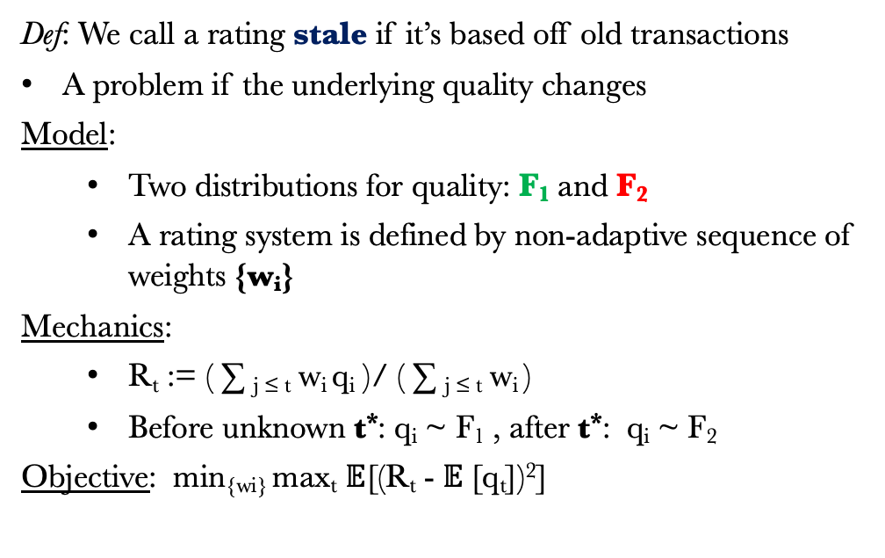
Rating System Design: Structure
Def: We call a rating stale if it’s based off old transactions
A problem if the underlying quality changes
Model:
Two distributions for quality: F₁ and F₂
A rating system is defined by non-adaptive sequence of weights {w_{i}}
Mechanics:
R_{t} := ( ∑ _{j ≤ t} w_{i} q_{i} )/ ( ∑ _{j ≤ t} w_{i} )
Before unknown t*: q_{i} ~ F₁ , after t*: q_{i} ~ F₂
Objective: min_{{wi}} max_{t} $𝔼$[(R_{t} - $𝔼$[q_{t}])²]
Qu: What kind of rating system stays fresh?
Simple average becomes stale

Slide 13
Rating System Design: Structure
Def: We call a rating stale if it’s based off old transactions
A problem if the underlying quality changes
Model:
Two distributions for quality: F₁ and F₂
A rating system is defined by non-adaptive sequence of weights {w_{i}}
Mechanics:
R_{t} := ( ∑ _{j ≤ t} w_{i} q_{i} )/ ( ∑ _{j ≤ t} w_{i} )
Before unknown t*: q_{i} ~ F₁ , after t*: q_{i} ~ F₂
Objective: min_{{wi}} max_{t} $𝔼$[(R_{t} - $𝔼$[q_{t}])²]
Qu: What kind of rating system stays fresh?
Simple average becomes stale
R₁ = w₁
q₁

Slide 14
Rating System Design: Structure
Def: We call a rating stale if it’s based off old transactions
A problem if the underlying quality changes
Model:
Two distributions for quality: F₁ and F₂
A rating system is defined by non-adaptive sequence of weights {w_{i}}
Mechanics:
R_{t} := ( ∑ _{j ≤ t} w_{i} q_{i} )/ ( ∑ _{j ≤ t} w_{i} )
Before unknown t*: q_{i} ~ F₁ , after t*: q_{i} ~ F₂
Objective: min_{{wi}} max_{t} $𝔼$[(R_{t} - $𝔼$[q_{t}])²]
Qu: What kind of rating system stays fresh?
Simple average becomes stale
R₁ = w₁q₁ /w₁
R₂ = w₁q₁ + w₂
q₂

Slide 15


Rating System Design: Structure
Def: We call a rating stale if it’s based off old transactions
A problem if the underlying quality changes
Model:
Two distributions for quality: F₁ and F₂
A rating system is defined by non-adaptive sequence of weights {w_{i}}
Mechanics:
R_{t} := ( ∑ _{j ≤ t} w_{i} q_{i} )/ ( ∑ _{j ≤ t} w_{i} )
Before unknown t*: q_{i} ~ F₁ , after t*: q_{i} ~ F₂
Objective: min_{{wi}} max_{t} $𝔼$[(R_{t} - $𝔼$[q_{t}])²]
Qu: What kind of rating system stays fresh?
Simple average becomes stale
R₁ = w₁q₁ /w₁
R₂ = (w₁q₁ + w₂ q₂)/(w₁ + w₂)
R₃ = w₁q₁ + w₂ q₂ + w₃
q₃

Slide 16

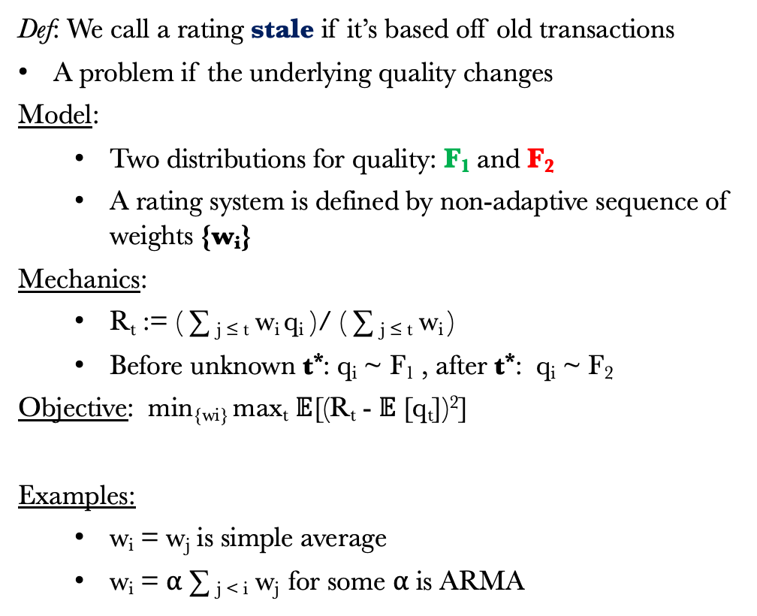
Rating System Design: Structure
Def: We call a rating stale if it’s based off old transactions
A problem if the underlying quality changes
Model:
Two distributions for quality: F₁ and F₂
A rating system is defined by non-adaptive sequence of weights {w_{i}}
Mechanics:
R_{t} := ( ∑ _{j ≤ t} w_{i} q_{i} )/ ( ∑ _{j ≤ t} w_{i} )
Before unknown t*: q_{i} ~ F₁ , after t*: q_{i} ~ F₂
Objective: min_{{wi}} max_{t} $𝔼$[(R_{t} - $𝔼$[q_{t}])²]
Examples:
w_{i} = w_{j} is simple average
w_{i} = ⍺ ∑ _{j < i} w_{j} for some ⍺ is ARMA
Qu: What kind of rating system stays fresh?
Simple average becomes stale
R₁ = w₁q₁ /w₁
R₂ = (w₁q₁ + w₂ q₂)/(w₁ + w₂)
R₃ = (w₁q₁ + w₂ q₂ + w₃ q₃)/(w₁ + w₂ + w₃)
Err₁ = $𝔼$[(R₁ - $𝔼$[q])²]
Err₂ = $𝔼$[(R₂ - $𝔼$[q])²]
Err₃ = $𝔼$[(R₃ - $𝔼$[q])²]
Want to minimizes max of

Slide 17
Rating System Design: Structure
Def. Any rating system such there exists sequence {w_{i}} which describes the rating system is oblivious
Theorem 1 [ARMA Ratings are Min-Max Optimal].
For any positive valued distributions F₁ and F₂ where the quality (q) switches adversarially, the optimal oblivious rating system that minimizes maximum expected MSE across time steps is always a moving average rating system.
R_{t} = (1-⍺) R_{t-1} + ⍺ q_{t}
Remarks
This model set-up is like a non-adaptive version of change point detection ^{[9,10]}
Any rating system that does not place a constant weight on the most recent outcome can go stale
Extends to multiple distribution changes with minor changes
Guidance for choosing ⍺ based on F₁ and F₂
[9] Lowry et al., 1995. A review of multivariate control charts
[10] Aminikhanghahi et al., 2017. survey of methods for time series change point detection

Slide 18
Rating System Design: Incentives and Fees
Def: On a platform disintermediation is when users connect to services on the platform but transact off the platform.
Model:
Service providers have quality q ~ F
Service providers disintermediate with a p
Users contract with provider with probability: h(R_{t})
R_{t} = (1-⍺)R_{t-1} + ⍺ g(Y_{t}), g(N) = 0, g(P) = 1, g(NR) = β
Mechanics:
If contracted with (prob. h(R_{t}))
Either transact on platform, pay fee f and get rating
Or transact off platform, no fee and no rating
Stackelberg game: First choose f, g then choose p
Objective: Maximize expected long-run seller revenue
Qu: What kind of rating system stops disintermediation?
If rating is high, why solicit more?

Slide 19
Rating System Design: Incentives and Fees
Def: On a platform disintermediation is when users connect to services on the platform but transact off the platform.
Model:
Service providers have quality q ~ F
Service providers disintermediate with a p
Users contract with provider with probability: h(R_{t})
R_{t} = (1-⍺)R_{t-1} + ⍺ g(Y_{t}), g(N) = 0, g(P) = 1, g(NR) = β
Mechanics:
If contracted with (prob. h(R_{t}))
Either transact on platform, pay fee f and get rating
Or transact off platform, no fee and no rating
Stackelberg game: First choose f, g then choose p
Objective: Maximize expected long-run seller revenue
Qu: What kind of rating system stops disintermediation?
If rating is high, why solicit more?
⍺ = .1, β = .5
R_{t} = .8

Slide 20
Rating System Design: Incentives and Fees
Def: On a platform disintermediation is when users connect to services on the platform but transact off the platform.
Model:
Service providers have quality q ~ F
Service providers disintermediate with a p
Users contract with provider with probability: h(R_{t})
R_{t} = (1-⍺)R_{t-1} + ⍺ g(Y_{t}), g(N) = 0, g(P) = 1, g(NR) = β
Mechanics:
If contracted with (prob. h(R_{t}))
Either transact on platform, pay fee f and get rating
Or transact off platform, no fee and no rating
Stackelberg game: First choose f, g then choose p
Objective: Maximize expected long-run seller revenue
Qu: What kind of rating system stops disintermediation?
If rating is high, why solicit more?
⍺ = .1, β = .5
R_{t} = .8
f, q

Slide 21
Rating System Design: Incentives and Fees
Def: On a platform disintermediation is when users connect to services on the platform but transact off the platform.
Model:
Service providers have quality q ~ F
Service providers disintermediate with a p
Users contract with provider with probability: h(R_{t})
R_{t} = (1-⍺)R_{t-1} + ⍺ g(Y_{t}), g(N) = 0, g(P) = 1, g(NR) = β
Mechanics:
If contracted with (prob. h(R_{t}))
Either transact on platform, pay fee f and get rating
Or transact off platform, no fee and no rating
Stackelberg game: First choose f, g then choose p
Objective: Maximize expected long-run seller revenue
Qu: What kind of rating system stops disintermediation?
If rating is high, why solicit more?
⍺ = .1, β = .5
R_{t+1} = .9(.8) + .1 q

Slide 22
Rating System Design: Incentives and Fees
Def: On a platform disintermediation is when users connect to services on the platform but transact off the platform.
Model:
Service providers have quality q ~ F
Service providers disintermediate with a p
Users contract with provider with probability: h(R_{t})
R_{t} = (1-⍺)R_{t-1} + ⍺ g(Y_{t}), g(N) = 0, g(P) = 1, g(NR) = β
Mechanics:
If contracted with (prob. h(R_{t}))
Either transact on platform, pay fee f and get rating
Or transact off platform, no fee and no rating
Stackelberg game: First choose f, g then choose p
Objective: Maximize expected long-run seller revenue
Qu: What kind of rating system stops disintermediation?
If rating is high, why solicit more?
⍺ = .1, β = .5
R_{t+1} = .82

Slide 23
Rating System Design: Incentives and Fees
Def: On a platform disintermediation is when users connect to services on the platform but transact off the platform.
Model:
Service providers have quality q ~ F
Service providers disintermediate with a p
Users contract with provider with probability: h(R_{t})
R_{t} = (1-⍺)R_{t-1} + ⍺ g(Y_{t}), g(N) = 0, g(P) = 1, g(NR) = β
Mechanics:
If contracted with (prob. h(R_{t}))
Either transact on platform, pay fee f and get rating
Or transact off platform, no fee and no rating
Stackelberg game: First choose f, g then choose p
Objective: Maximize expected long-run seller revenue
Qu: What kind of rating system stops disintermediation?
If rating is high, why solicit more?
⍺ = .1, β = .5
R_{t+1} = .82
($$$)

Slide 24
Rating System Design: Incentives and Fees
Def: On a platform disintermediation is when users connect to services on the platform but transact off the platform.
Model:
Service providers have quality q ~ F
Service providers disintermediate with a p
Users contract with provider with probability: h(R_{t})
R_{t} = (1-⍺)R_{t-1} + ⍺ g(Y_{t}), g(N) = 0, g(P) = 1, g(NR) = β
Mechanics:
If contracted with (prob. h(R_{t}))
Either transact on platform, pay fee f and get rating
Or transact off platform, no fee and no rating
Stackelberg game: First choose f, g then choose p
Objective: Maximize expected long-run seller revenue
Qu: What kind of rating system stops disintermediation?
If rating is high, why solicit more?
⍺ = .1, β = .5
R_{t+1} = .9(.82)+.1(.5)

Slide 25
Rating System Design: Incentives and Fees
Def: On a platform disintermediation is when users connect to services on the platform but transact off the platform.
Model:
Service providers have quality q ~ F
Service providers disintermediate with a p
Users contract with provider with probability: h(R_{t})
R_{t} = (1-⍺) R_{t-1} + ⍺ g(Y_{t}), g(N) = 0, g(P) = 1, g(NR) = β
Mechanics:
If contracted with (prob. h(R_{t}))
Either transact on platform, pay fee f and get rating
Or transact off platform, no fee and no rating
Stackelberg game: First choose f, g then choose p
Objective: Maximize expected long-run seller revenue
Qu: What kind of rating system stops disintermediation?
If rating is high, why solicit more?
⍺ = .1, β = .5
R_{t+2} = .788

Slide 26
Rating System Design: Incentives and Fees
Def: On a platform disintermediation is when users connect to services on the platform but transact off the platform.
Model:
Service providers have quality q ~ F
Service providers disintermediate with a p
Users contract with provider with probability: h(R_{t})
R_{t} = (1-⍺) R_{t-1} + ⍺ g(Y_{t}), g(N) = 0, g(P) = 1, g(NR) = β
Mechanics:
If contracted with (prob. h(R_{t}))
Either transact on platform, pay fee f and get rating
Or transact off platform, no fee and no rating
Stackelberg game: First choose f, g then choose p
Objective: Maximize expected long-run seller revenue
Qu: What kind of rating system stops disintermediation?
If rating is high, why solicit more?
⍺ = .1, β = .5
R_{t+3} = .9(.76) + .1(??)

Slide 27
Rating System Design: Incentives and Fees
Set-up: The platform needs to choose a fee per transaction f, and “no-show” rating g(NR) = β
Theorem 2 [Approximately Optimal Rating Design].
For any level of minimum service quality c, and any distribution of quality F supported on (c,1], when the probability of being hired is proportional to R_{t} , choosing:
(β, f) = ( (1 – (1 – c)^{1/2} + c)/2 , ((1 – c)^{1/2} - 1 + c)/2 )
gives a 3/4 approximation of the long-run optimal achievable revenue for the platform.
Remarks
Can show all service providers either never disintermediate or always do and wash out
An intermediate value of β makes it punishing to transact off the platform, but not as punishing as providing poor service
Optimal policy depends on distribution, ¾ approximation is distribution agnostic

Slide 28
Conclusions
C1. Introduced a moving average inspired rating system to address staling and disintermediation
C2. By assigning a constant weight to the most recent outcome the platform can prevent staling
The parameter ⍺ can be tuned to trade-off change point detection and rating sensitivity
This is optimal for a min-max objective that protects customers from worst case outcomes
C3. By down-weighting ratings due to perceived inactivity the platform can prevent disintermediation
The processing function g can be tuned to penalize inactivity, incentivizing high quality service providers to transact on the platform and generating revenue
We give theory for setting g and the fee f that is detail-free and approximately optimal
R_{t} = (1-⍺) R_{t-1} + ⍺ g(Y_{t}) where Y_{t} 𝜖 {N, P, NR}

Slide 29
Thank You!
This is a work in progress, a full paper is coming soon.
Comments, questions, and suggestions are very welcome!
If you like this work, Titing Cui is on the ‘23/’24 Academic Job Market
More of his work at: https://tcui-pitt.github.io/
You can find these slides at: https://mhamilton-pitt.github.io/publications/
Contact: tic54@pitt.edu , mhamilton@katz.pitt.edu
R_{t} = (1-⍺) R_{t-1} + ⍺ g(Y_{t})
Time for bonus content?

Slide 30
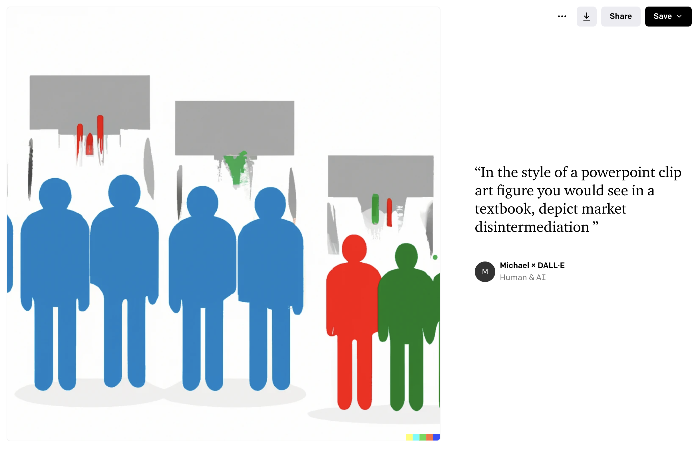
(Mis)Adventures in AI: Drawing Market Disintermediation
4/10

Slide 31
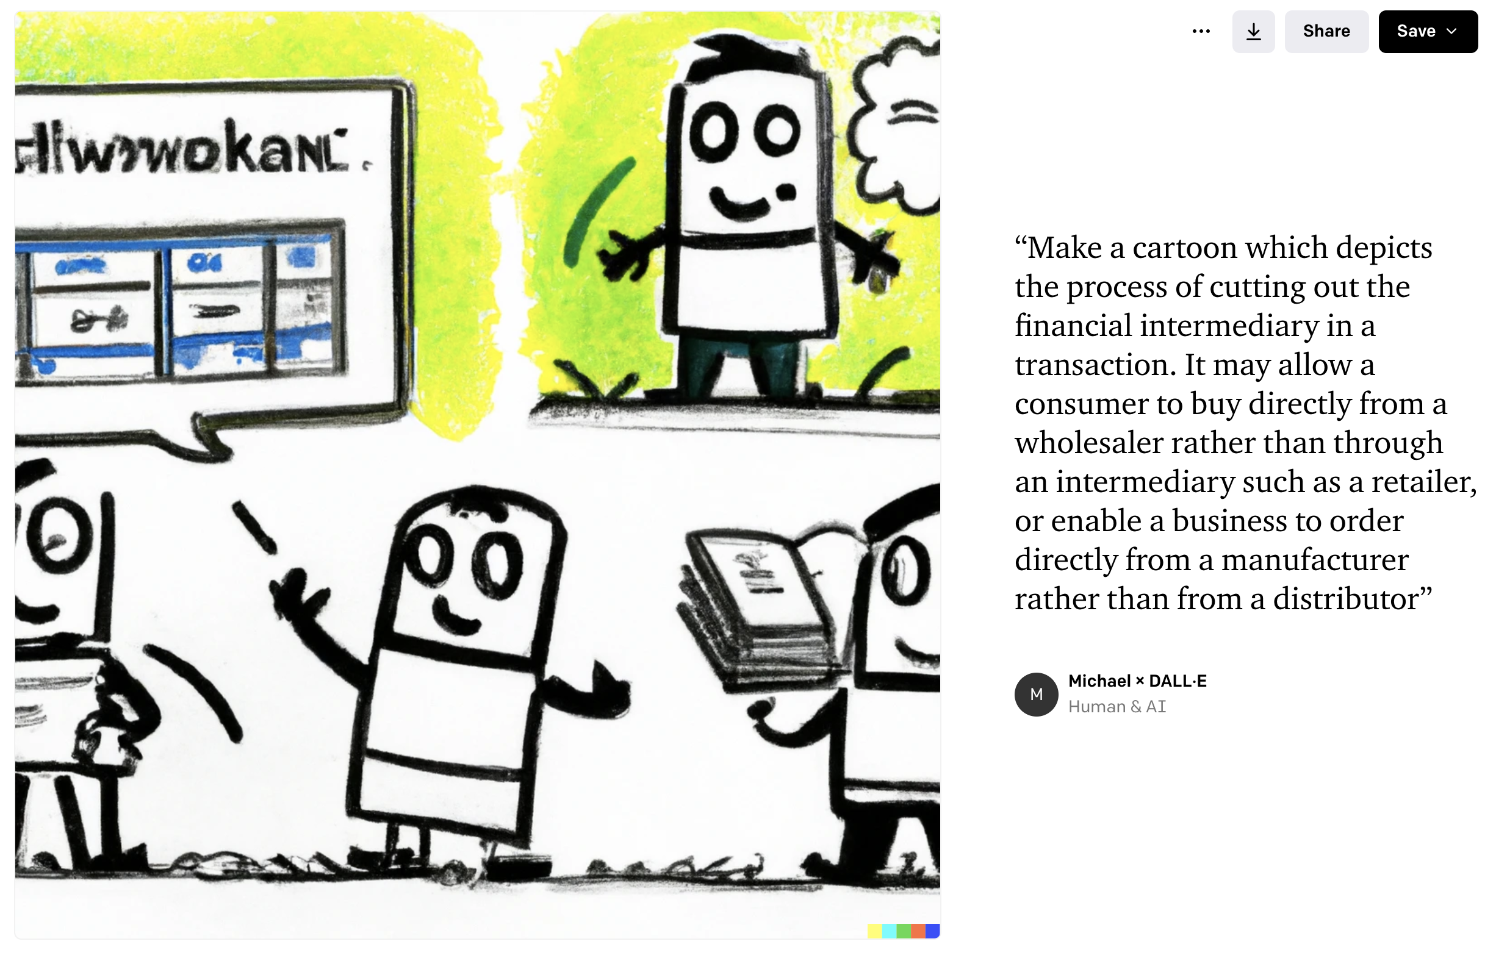
(Mis)Adventures in AI: Drawing Market Disintermediation
6/10

Slide 32
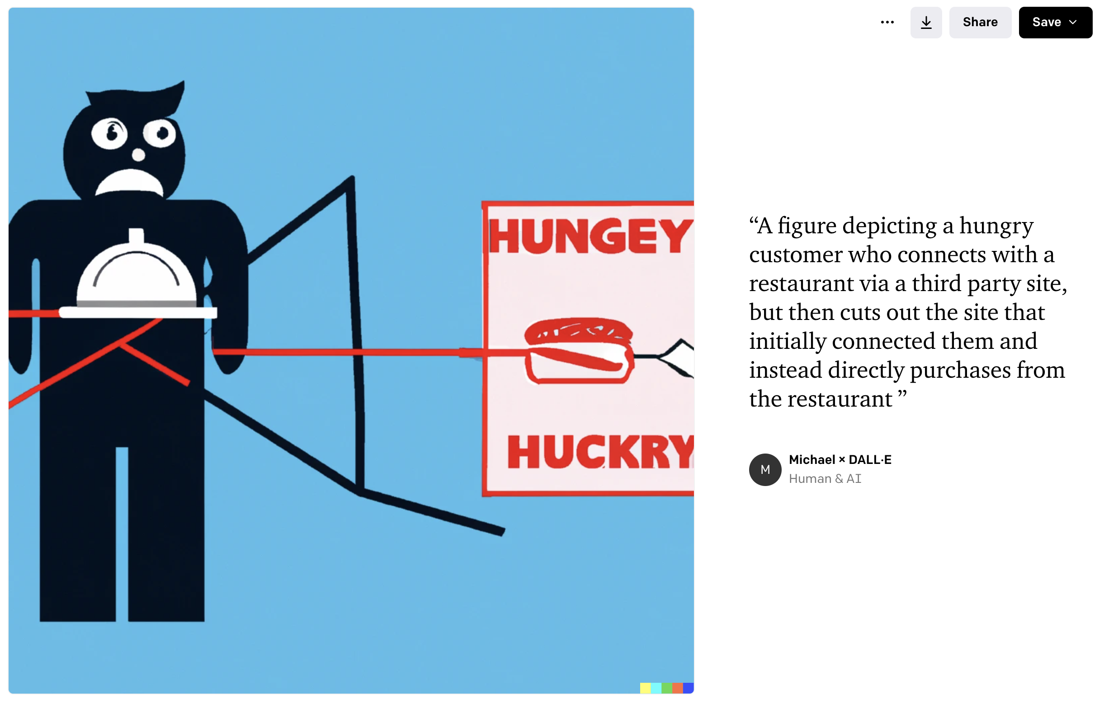
(Mis)Adventures in AI: Drawing Market Disintermediation
???/10

Slide 33
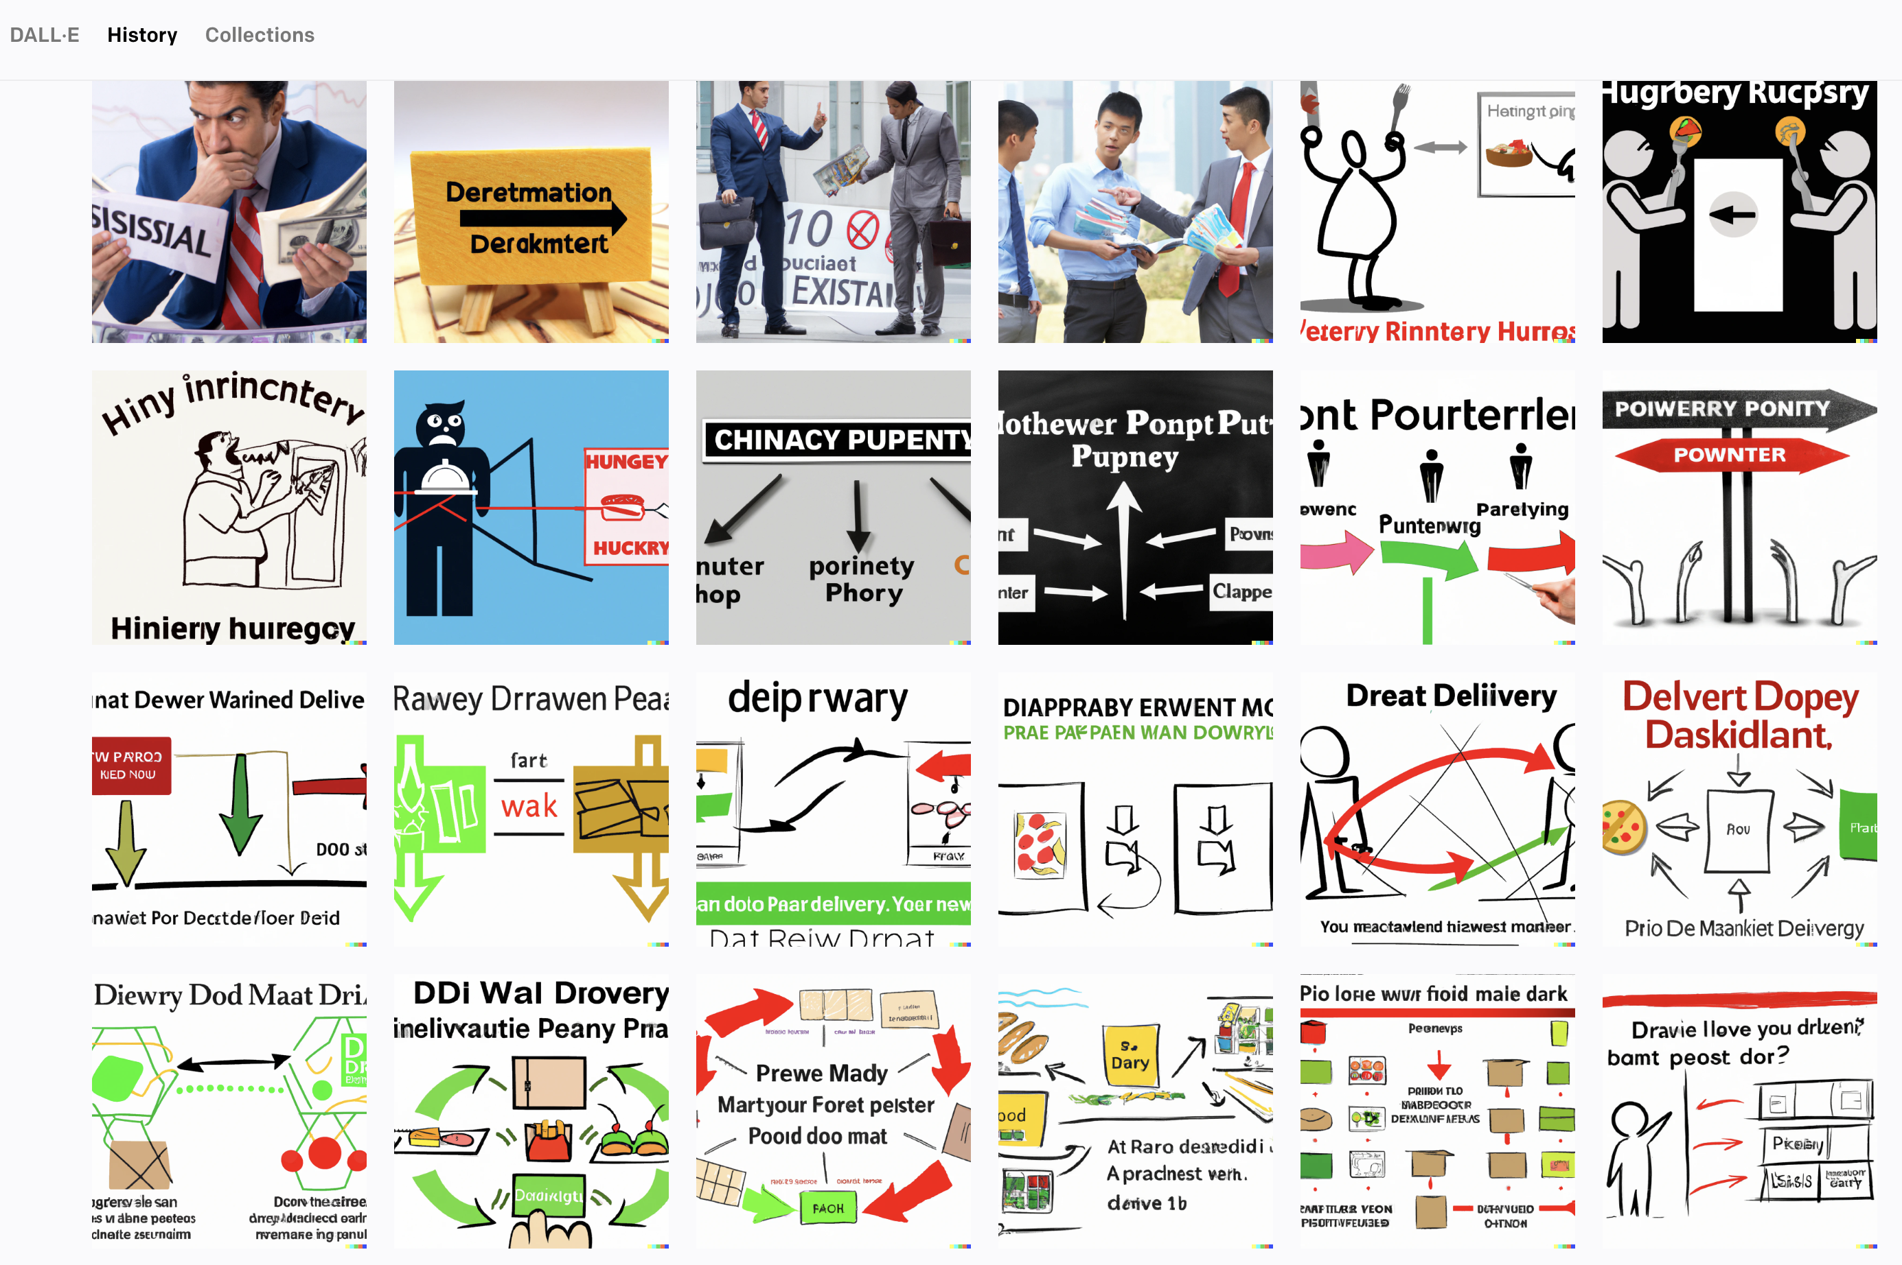
(Mis)Adventures in AI: Drawing Market Disintermediation

Slide 34
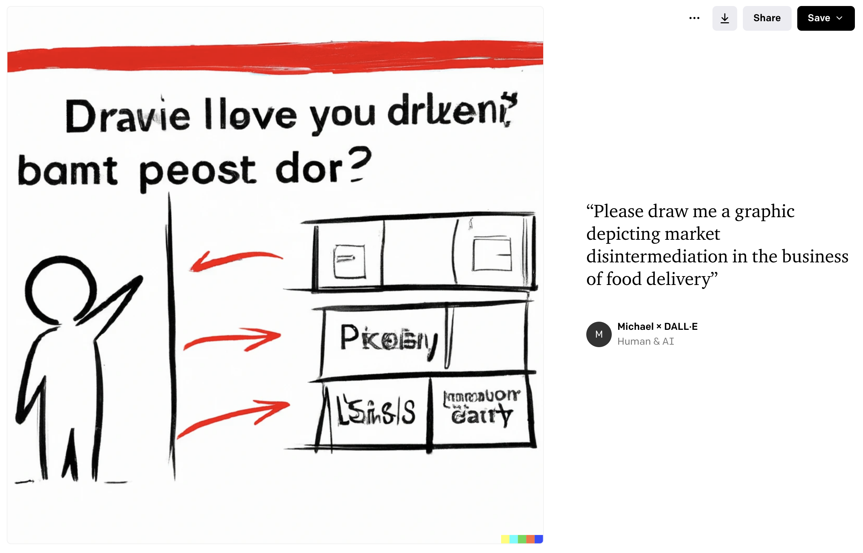
(Mis)Adventures in AI: Drawing Market Disintermediation
❤️/10

